Slide 1
Store Manager
Deborah Rempala

Slide 2
Purpose
Let’s a user to add, modify, view and delete
Employee Information
Item information
Special Order information
Real world
Less clutter for small businesses

Slide 3
Nuts and Bolts
Client side is done is C#.
Each different type of data has it’s own menu
Four functions for each type of data.
The server side was done in Perl.
Originally was going to be ran in master script, but that didn’t work
Six different servers were used instead.
Data is saved to a text file.

Slide 4
Adding to the Text File
A user can add to the text file
Employee information
Special Order information
Item Information

Slide 5
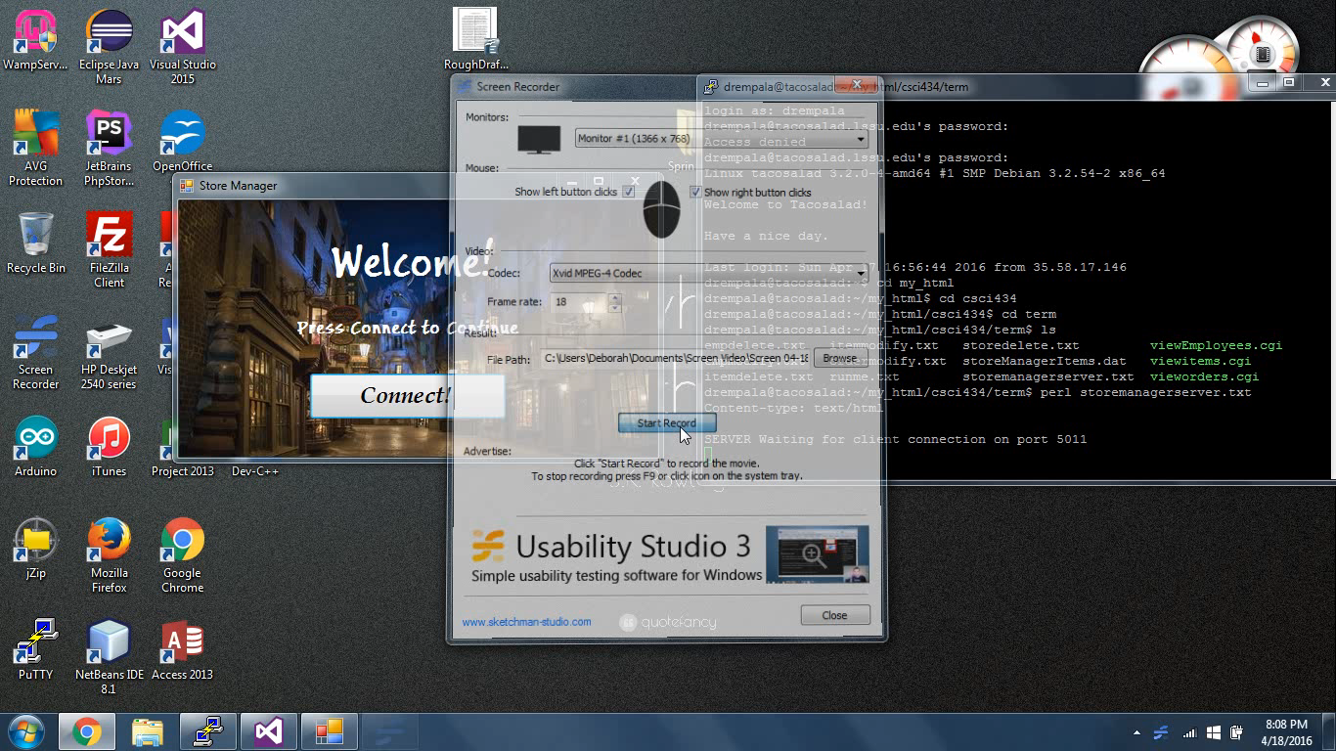

Slide 6
Deleting From The Text File
A user can delete from the text file
Employee Information
Special Order
Items

Slide 7
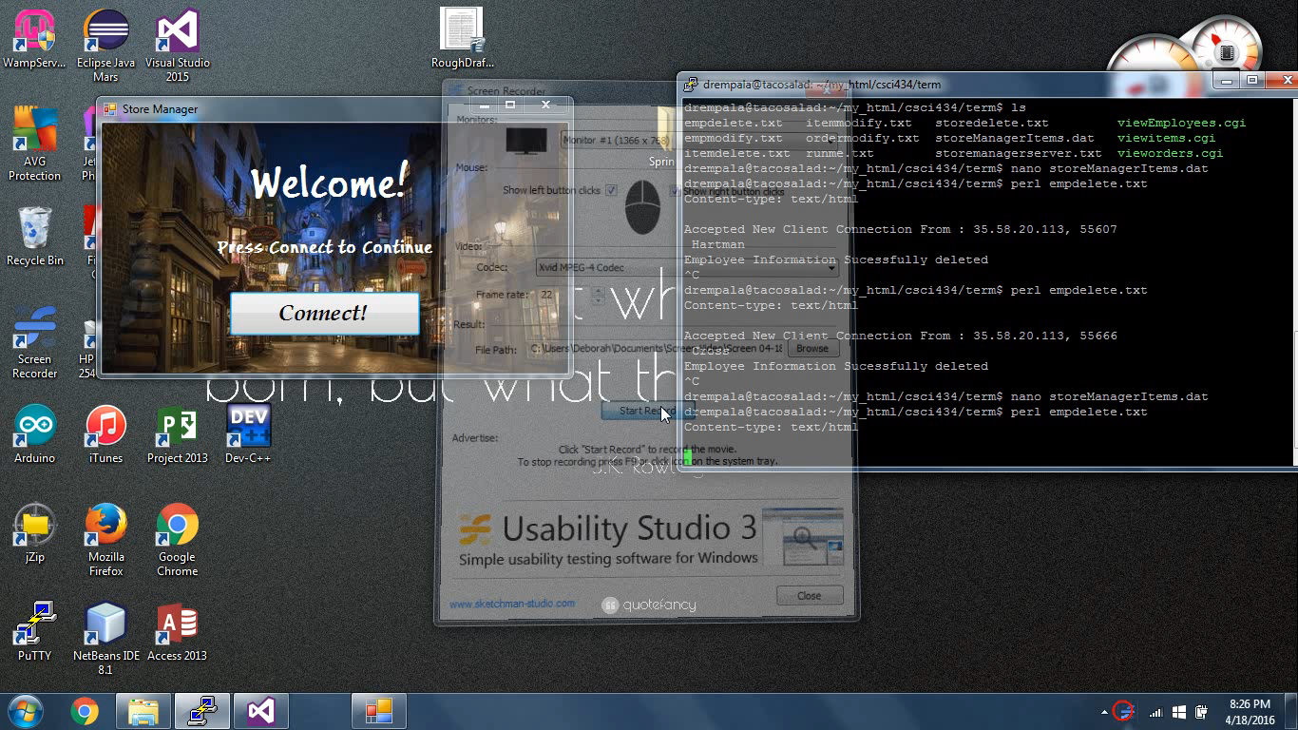

Slide 8
Modifying A Text File
A user can modify the text file
Employee Information
Special Orders
Item Information

Slide 9
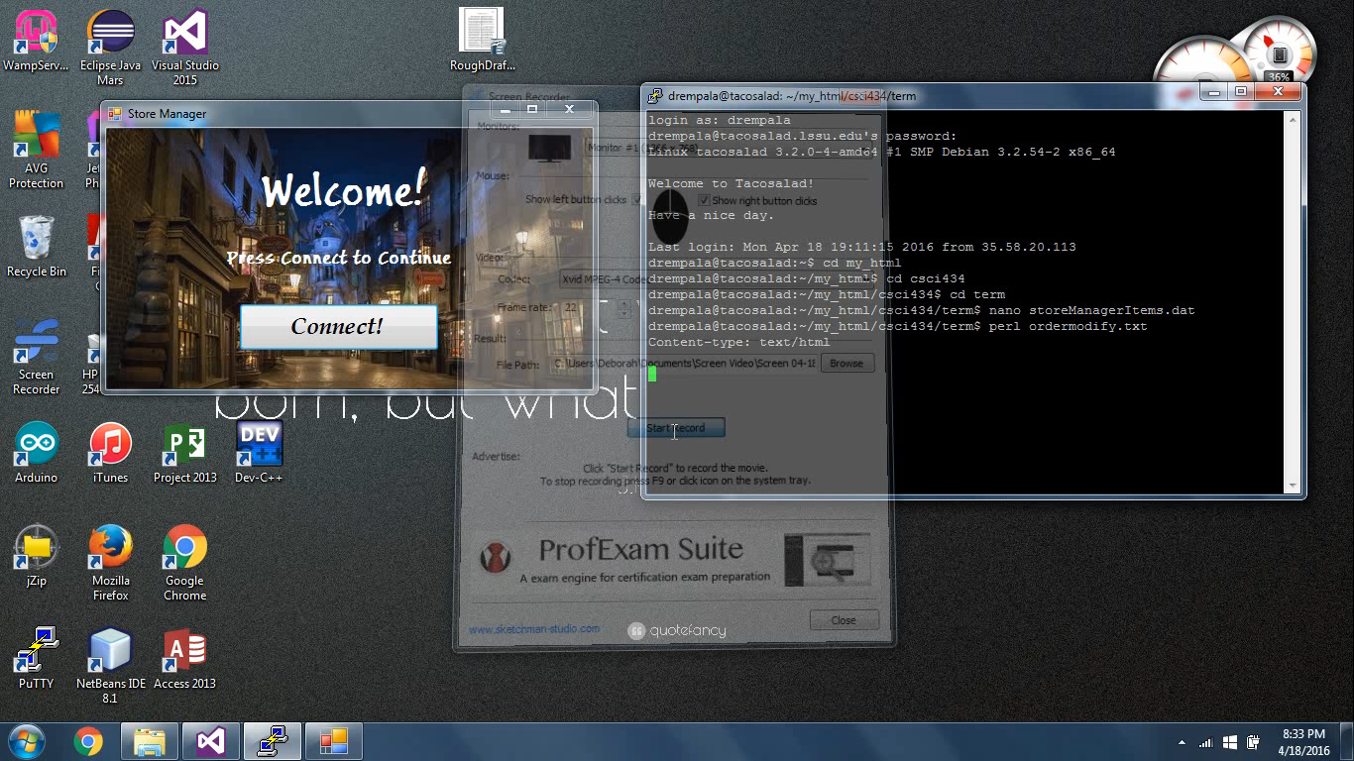

Slide 10
Conclusion
For the future
Get the modification function to correctly delete and update
Security
Easily Adaptable
Item Information
Employee Information

Slide 11
Any Questions?

